Slide 1

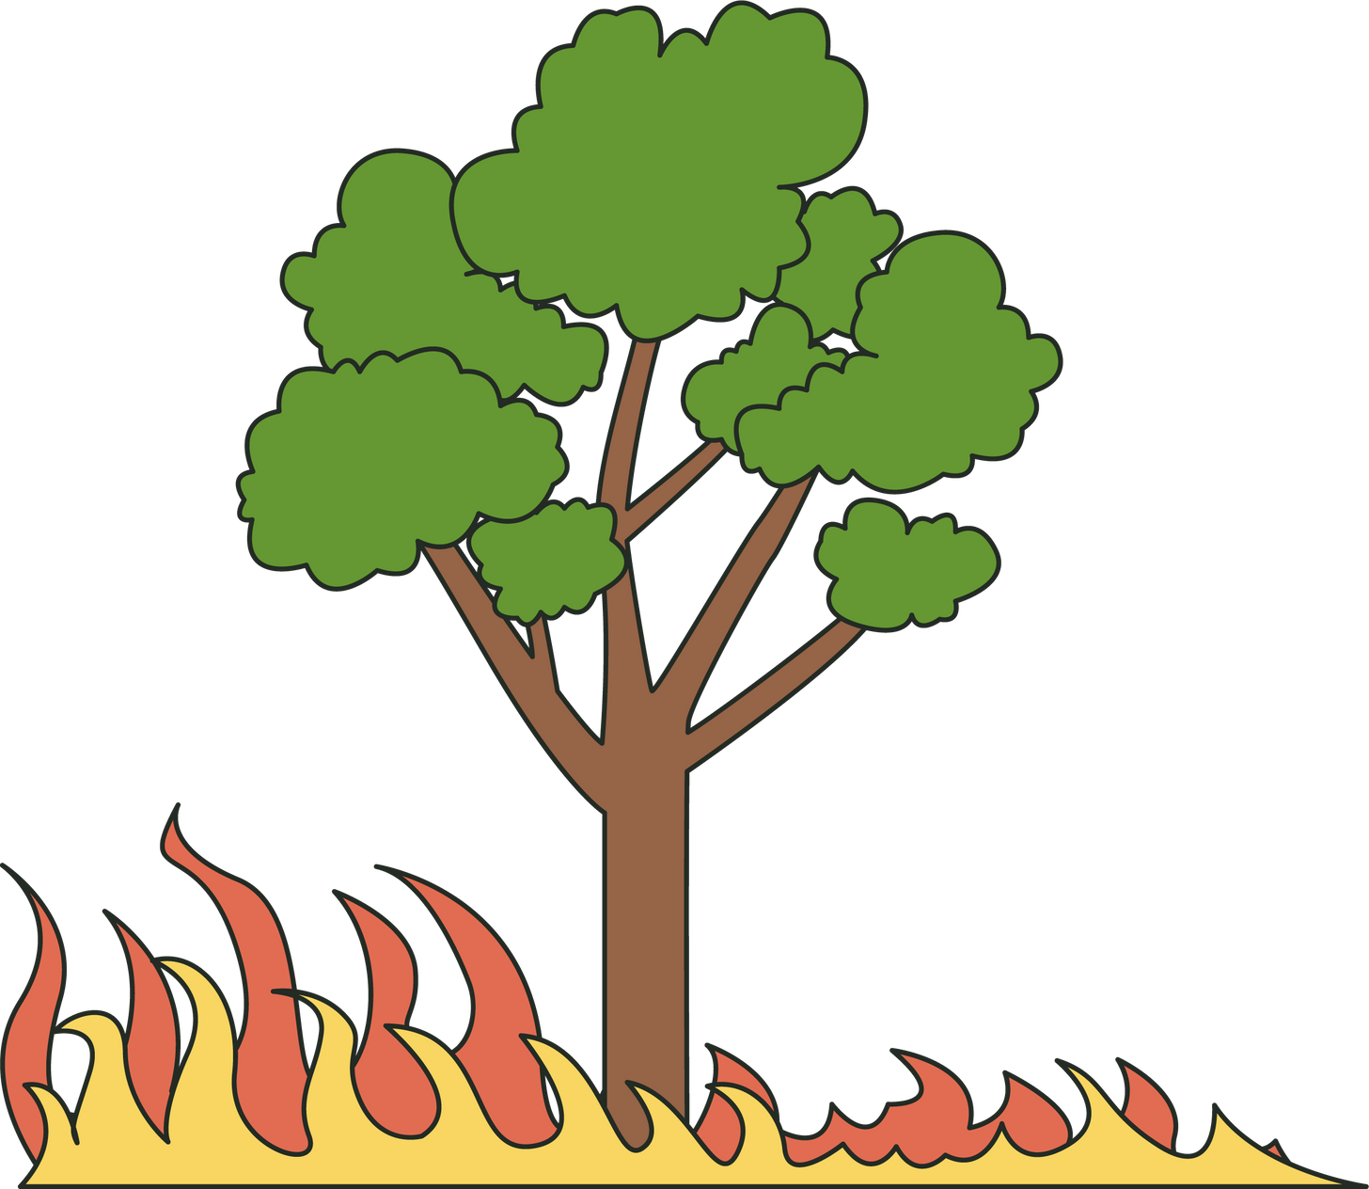
WILDFIRE DETECTION
Name - Rucha Tirodkar 20010923
1

Slide 2

OUTLINE
Sr.no | Title | Page No.
1 | What is Wildfire? | 4
2 | Proposal | 5
3 | Data sources | 6
4 | About this Data | 7
5 | Feature description | 8
6 | Implementation Plan | 10
7 | Checking for missing data | 11
3

Slide 3
OUTLINE
Sr.no | Title | Page No.
8 | Data Analysis | 12
9 | Machine learning algorithm used | 17
10 | Decision Tree | 18
11 | Multi Layer Perceptron | 22
12 | Support vector machine | 26
13 | Result Comparison | 28
14 | Conlusion and References | 29
4

Slide 4
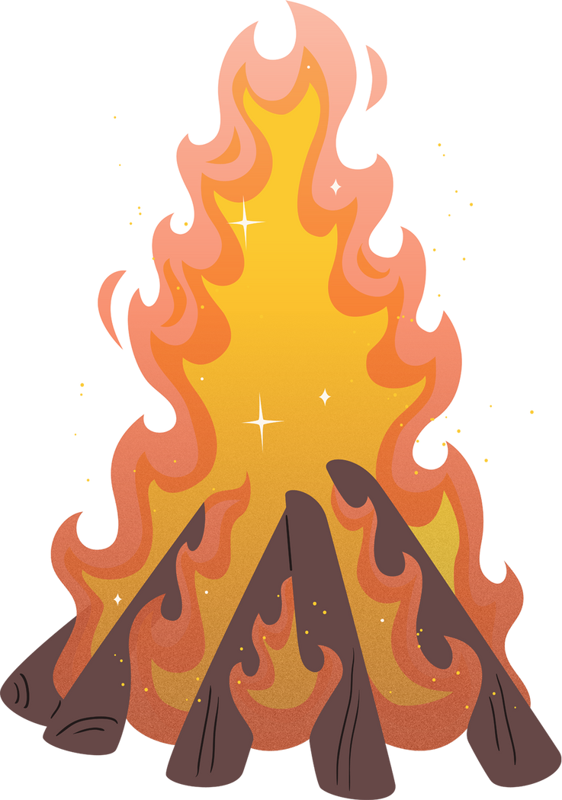
What is wildfire?
A wildfire is an uncontrolled fire that burns in the wildland vegetation, often in rural areas.
Wildfires can burn in forests, grasslands, savannas, and other ecosystems, and have been doing so for hundreds of millions of years.
Wildfires are among the most common forms of natural disaster in some regions, including Siberia, California, and Australia. Areas with Mediterranean climates are particularly susceptible.
5

Slide 5
Proposal
First the creation of the training and testing dataset.
After that, scan the data to identify missing or irregular data as well as the distribution of each feature.
After screening, data must be cleaned to create a trainable set. In addition to creating data, we will also create algorithms (SVM, Random forest, decision tree).
Once we have the model and the data, we will train the model and evaluate its performance on the test set using the metrics of recall, precision, and F1-score.
2

Slide 6
Data Sources
Geographic and wildfire data from the State of the California
- 4,279 fires from July 1, 2008 to December 31, 2020
Weather data from World Weather Online
Historical weather records every day in the same range
Aggregated to a monthly basis
6

Slide 7

About the data set
The Dataset contains:
10,988 records
4,297 of which had fires
Additional features such as :
Monthly weather averages
Quarterly weather averages
Quarterly cumulative precipitation
Acres burned
Cause of fire
Geo Location
7

Slide 8
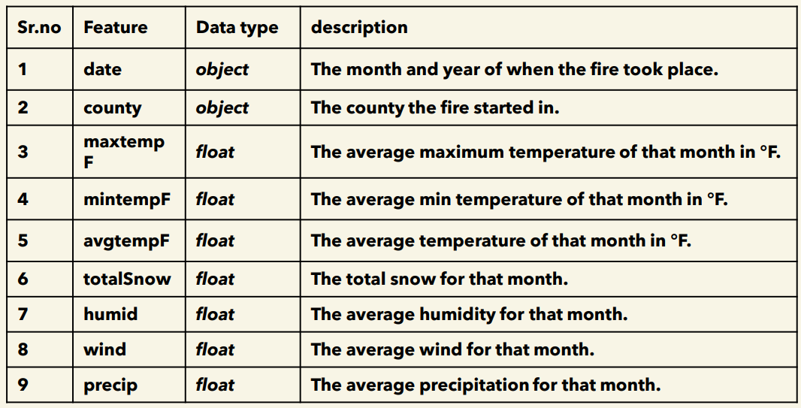
Feature Description
Feature Description
About the data set
8

Slide 9
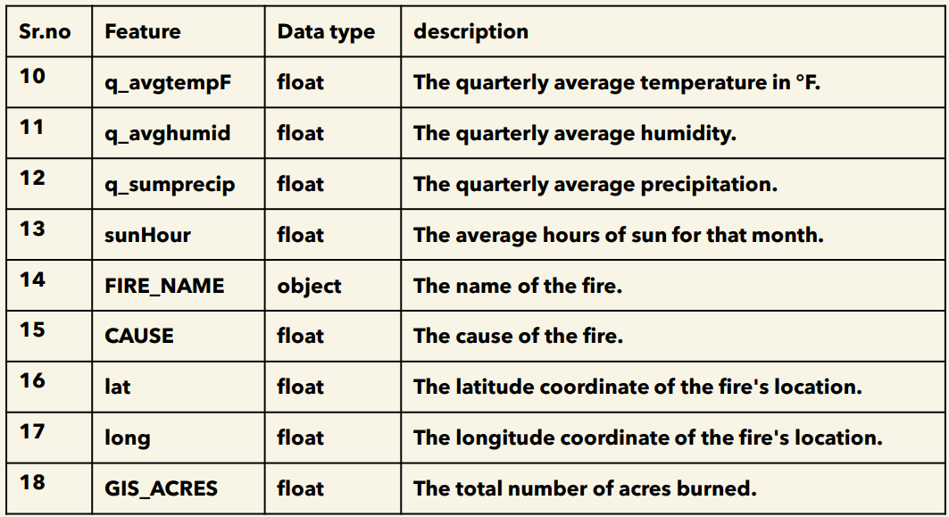
Feature Description
Feature Description
About the data set
9

Slide 10
Implementation plan
First scan the data to identify missing or irregular data as well as the distribution of each feature.
After screening, data analysis and correlation plotting
After that, the creation of the training and testing dataset
After screening, data must be cleaned to create a trainable set. In addition to creating data, we will also create algorithms (SVM, Random forest, decision tree).
Once we have the model and the data, we will train the model and evaluate its performance on the test set using the metrics of recall, precision, and F1-score
10

Slide 11
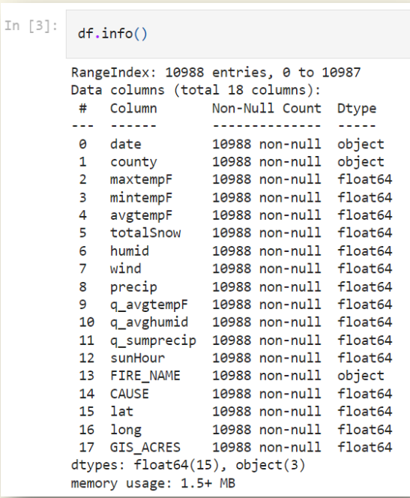
Checking for missing data
As we can see no null values were found in the data set
If any null value were to be found the non null count would be less than 10988 for that particular feature
11

Slide 12
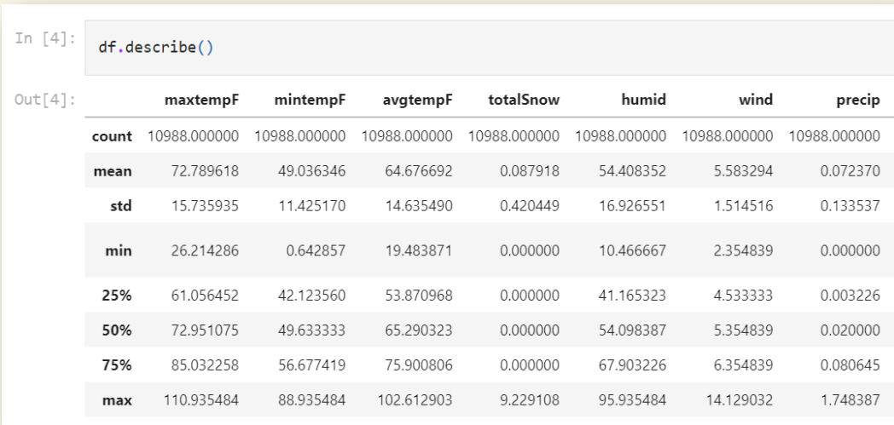
Data analysis - 1
To have the basic understanding of independent features which will be used for training the machine learning models
12

Slide 13
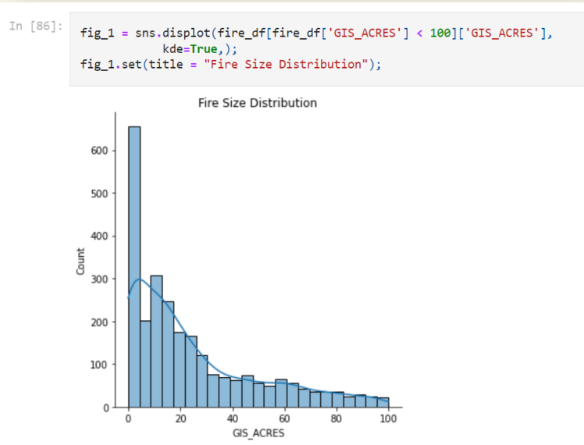
Data analysis - 2
Plotting number of fires vs number of acres burned
As we can see, most fires that occurred in our data burned less than 100 acres
13

Slide 14

Data analysis - 3
Plotting correlation heatmap using seaborn
We can see that there are no real strong correlations or patterns between variables that are independent from each other
There are some strong correlations in the heatmaps, but that is because the variables are depended (i.e. The total amount of snow and the precipitation levels)
Heatmap on the next slide
14

Slide 15
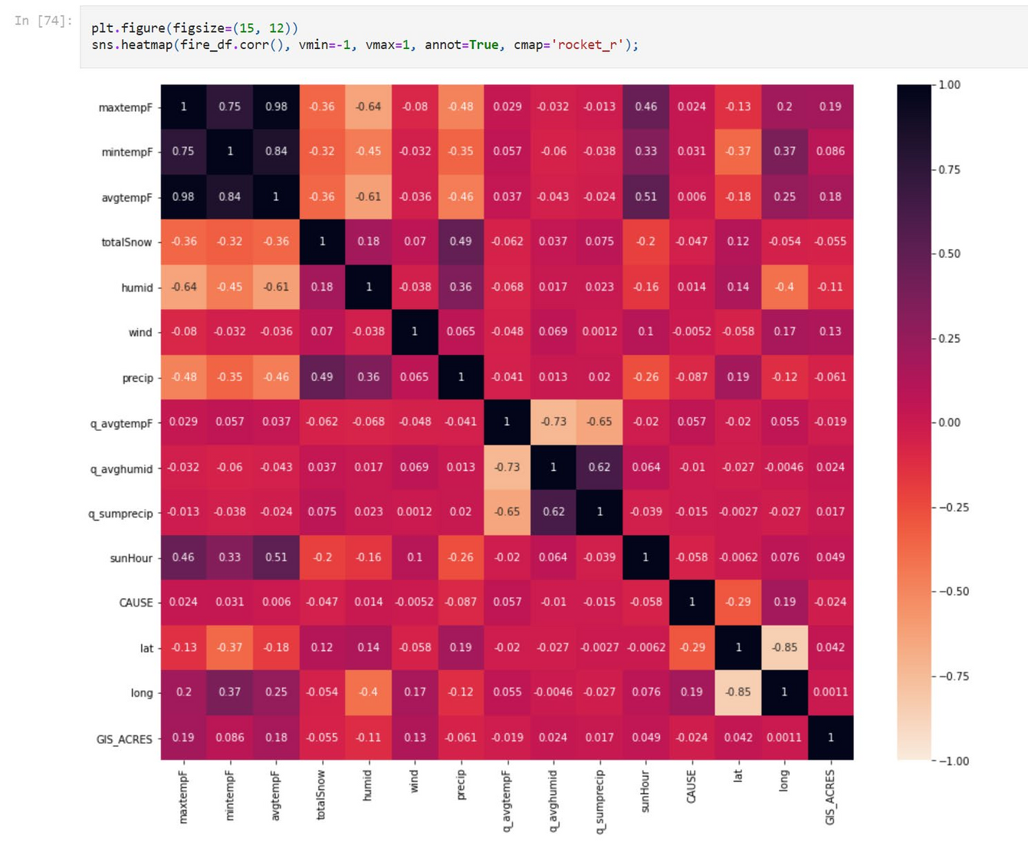

Correlation heatmap
15

Slide 16
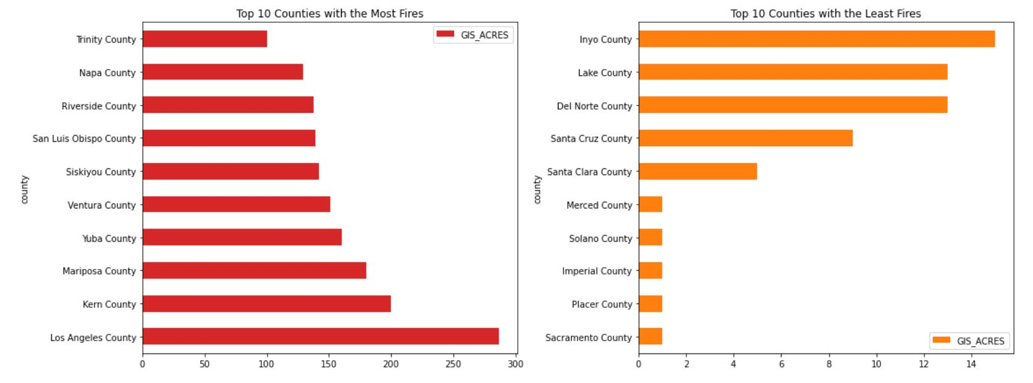
Data analysis - 4
Plotting counties with most and least fires in the past using matplotlib
As we can see Los Angeles County has the mostnumber of fires while Sacramento County has the least. This might be due to Los Angeles being the largest city in California. Because of that there are more people which means there is a higher chance fire will occur
16

Slide 17
Machine Learning Algorithms Used
Now we will split the data set into training set and testing set and will create functions for Machine Learning algorithms
The following Machine Learning algorithms:
a. Decision Tree
b. Multilayer Perceptron
c. Support Vector Machine
17

Slide 18

Decision Tree
Decision tree :
Hierarchical structure that used to classify classes based on a set of rules.
Decision tree is also efficient and requires less effort in preprocessing data
One of the disadvantages of this method is that it tends to be over-fitting
Random forest:
Random forest is an ensemble classifier, that works on the basis of a decision tree algorithm.
Based on the concept of randomization, random forest creates a collection of independent and non-identical decision trees.
18

Slide 19
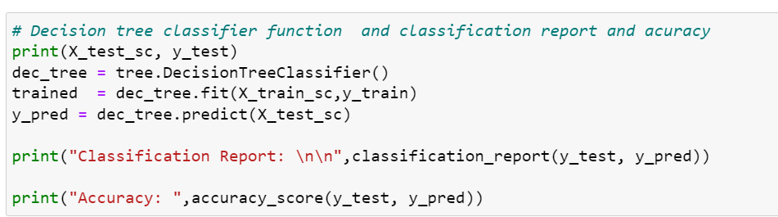
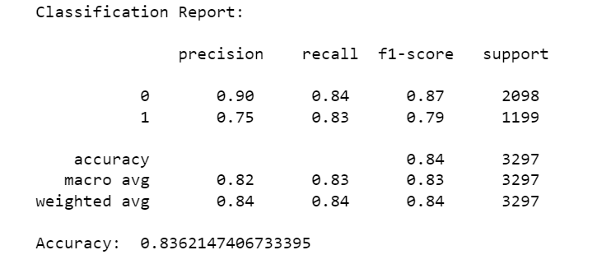
Decision Tree Results
IMPLEMENTATION:
RESULT:
19

Slide 20
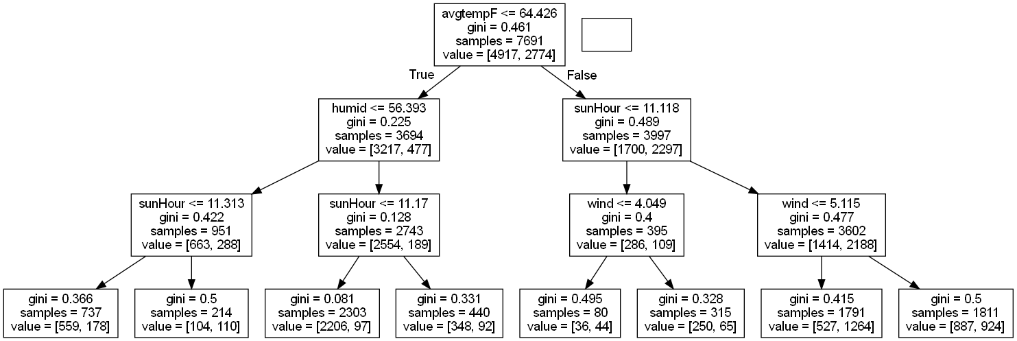
Pruned Decision Tree
Pruned decision tree to identify the most effective parameters
20

Slide 21
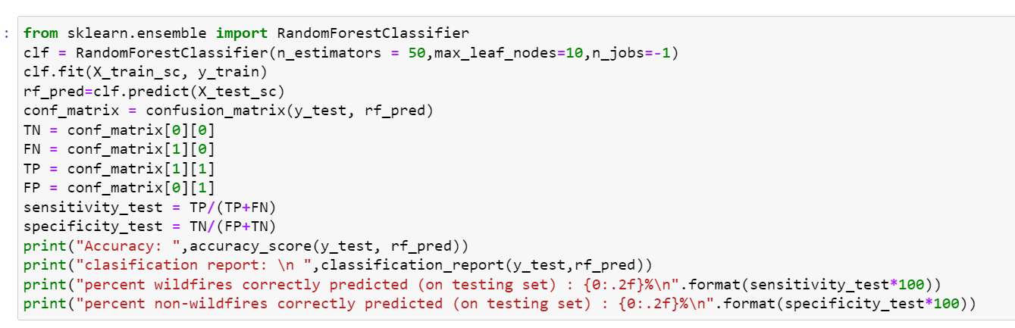
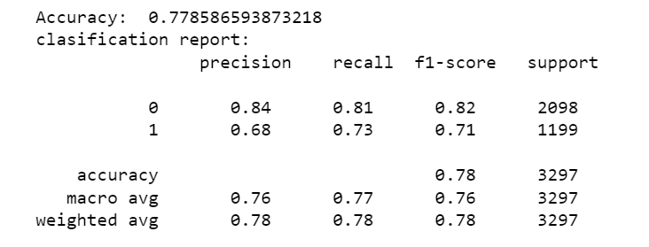
Random Forest Results
IMPLEMENTATION:
RESULT:
21

Slide 22
Multi Layer Perceptron
The regression Multi-layer Perceptron was chosen due to the binary nature of the output that was being predicted whether there was a fire at a location within the geographic bounds of California An input layer, hidden layers, and an output layer make up the MLP.
With the MLP, three distinct activation functions—Sigmoid, Relu, and Hyperbolic Tangent—were available for training the model within the hidden layers.
22

Slide 23
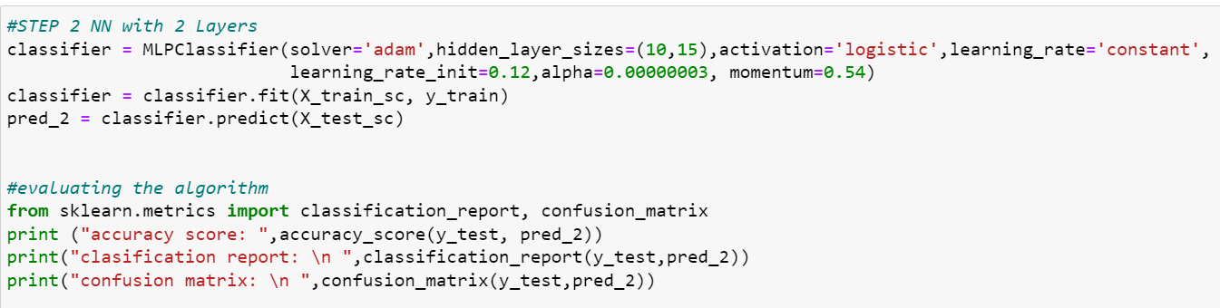
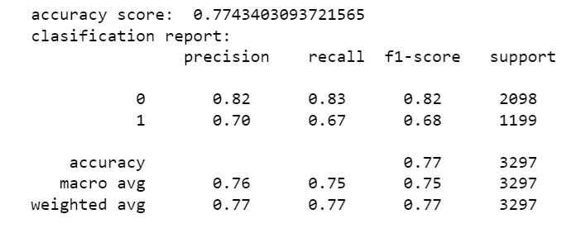
MLP Classifier 2 Hidden Layers Results
IMPLEMENTATION:
RESULT:
23

Slide 24
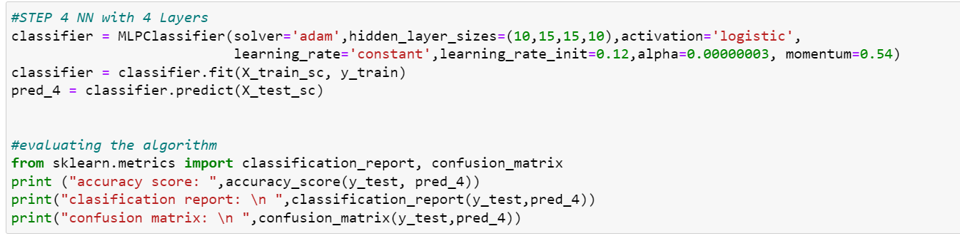
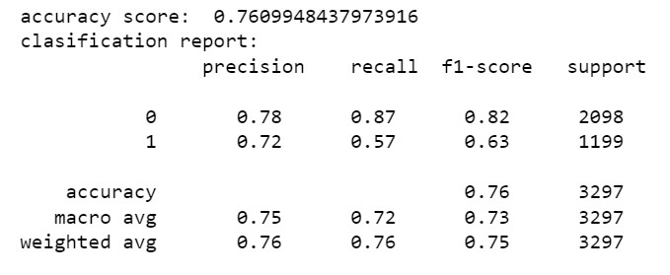
MLP Classifier 4 Hidden Layers Results
IMPLEMENTATION:
RESULT:
24

Slide 25
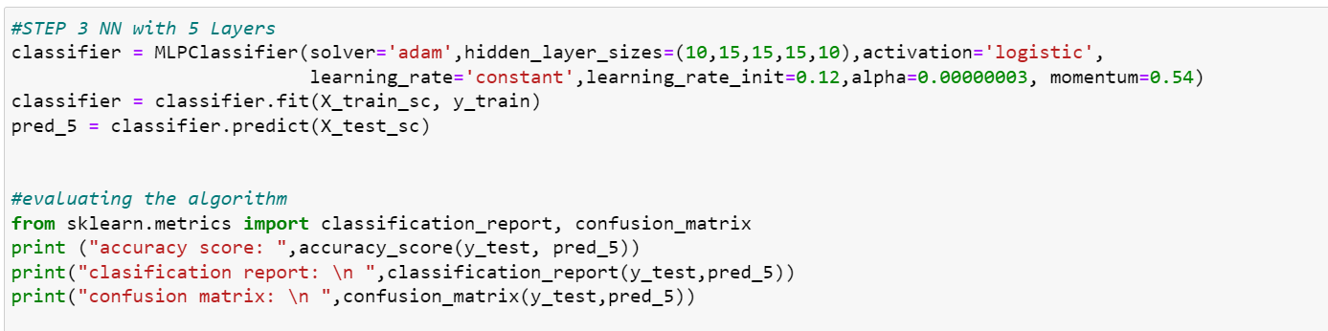
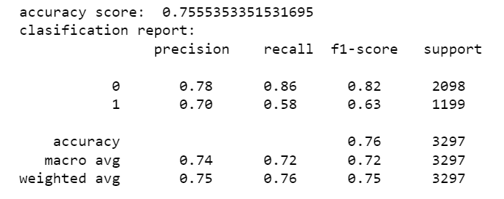
MLP Classifier 5 Hidden Layers Results
IMPLEMENTATION:
RESULT:
25

Slide 26
Support Vector Machine
A support vector machine (SVM) is a supervised machine learning model that uses classification algorithms for two-group classification problems
SVM works by mapping data to a high-dimensional feature space so that data points can be categorized, even when the data are not otherwise linearly separable.
A separator between the categories is found, then the data are transformed in such a way that the separator could be drawn as a hyperplane
Following this, characteristics of new data can be used to predict the
occurrence of wildfire
26

Slide 27
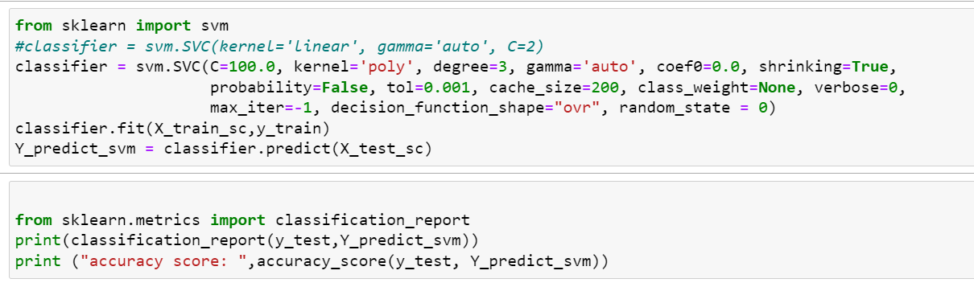
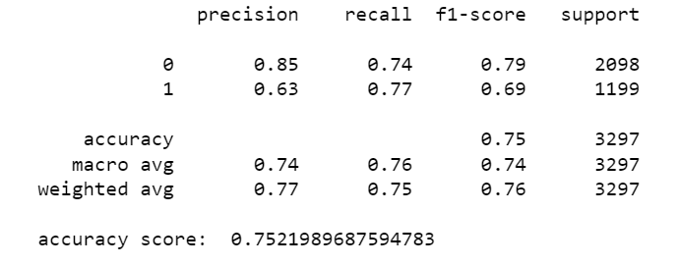
Support Vector Machine Results
IMPLEMENTATION:
RESULT:
27

Slide 28

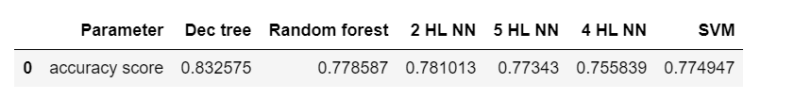
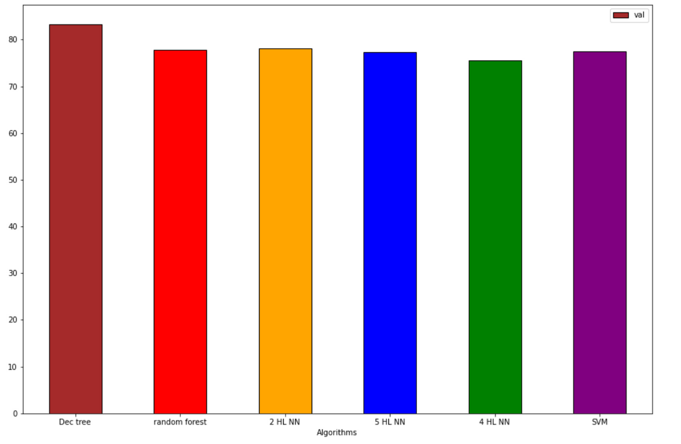
Result Comparison
Accuracy Comparison Dataframe:
Accuracy Comparison Bar Graph:
28

Slide 29
Conclusion
Decision tree came out on top with 83% percent accuracy score Random forest has average results due to nonlinear correlation present between features.
Multilayer perceptron and SVM both gave average results due to overfitting caused by high number of features present in the dataset.
29

Slide 30
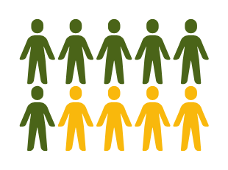
References
• "California Department of Forestry and Fire Protection", [online] Available: https://www.fire.ca.gov/stats-events/.
• Ashima Malik et al. “Wildfire Risk Prediction and Detection using Machine Learning in San Diego, California”. In: Oct. 2021.
•https://www.kaggle.com/datasets/ananthu017/california-wildfire-incidents-20132020
• M. E. Alsahaft, M. A. Alharthi and M. Arif, "Role of Machine Learning Algorithms in Forest Fire Management: A Literature Review", J. Robot. Autom., vol. 5, pp. 212-226, February 2018.
• S. Youssef and B. Abdelaziz, "Prediction of Forest Fires Using Artificial Neural Networks", Appl. Math. Sci., vol. 7, pp. 271-286, January 2013

